Slide 1
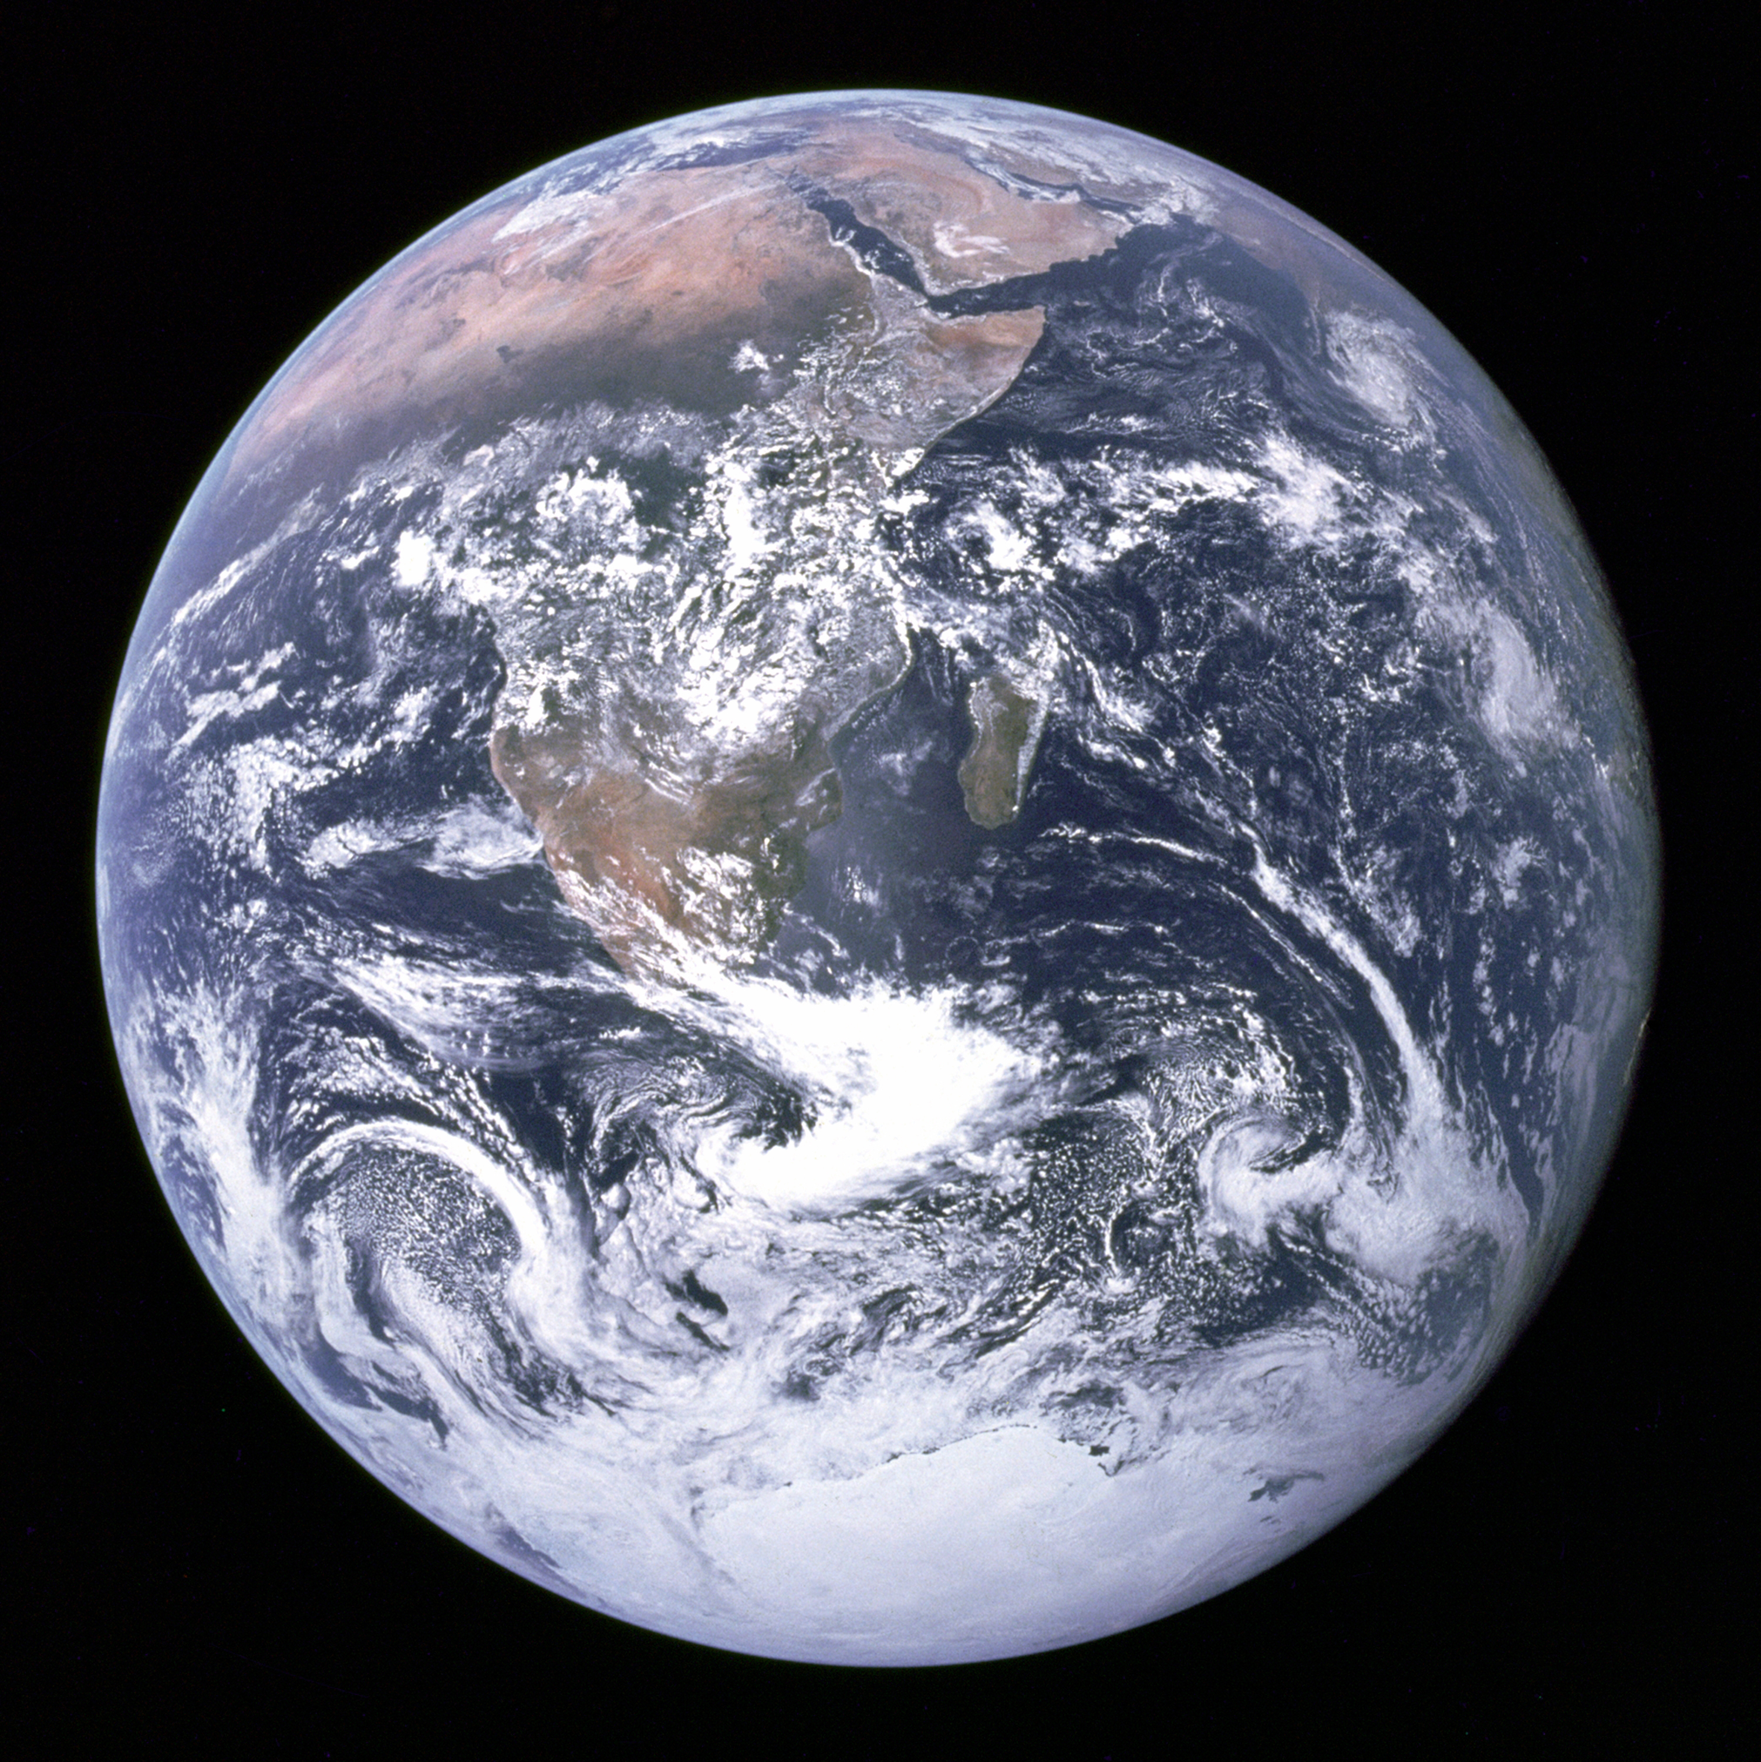
Notes:
The ”Blue Marble” photographed by Apollo 17.

Slide 2
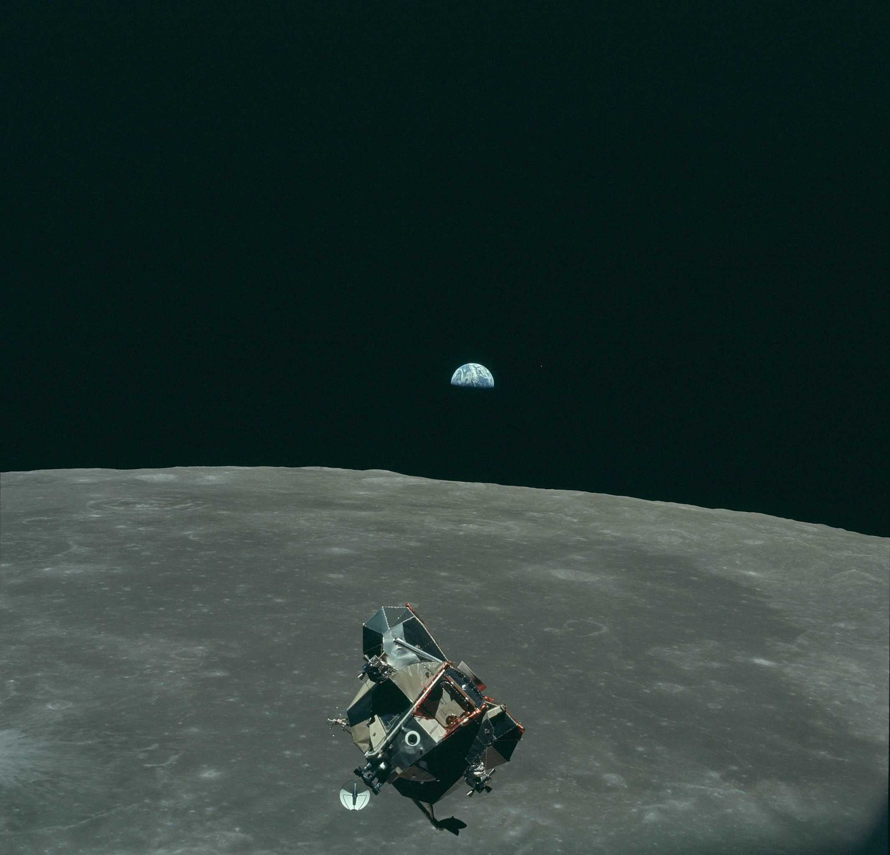

Slide 3
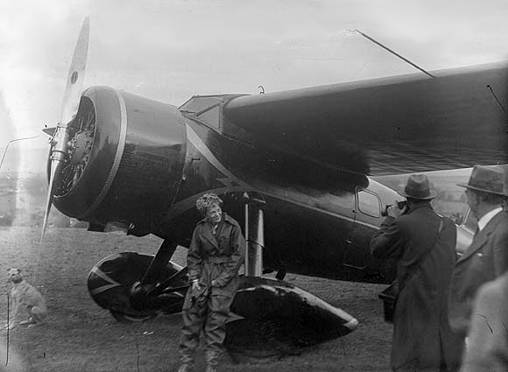
Notes:
20th May 1932 Amelia Earhart took off in her Lockheed Vega from Harbour Grace in Canada. She called her plane the ‘Little Red Bus’

Slide 4
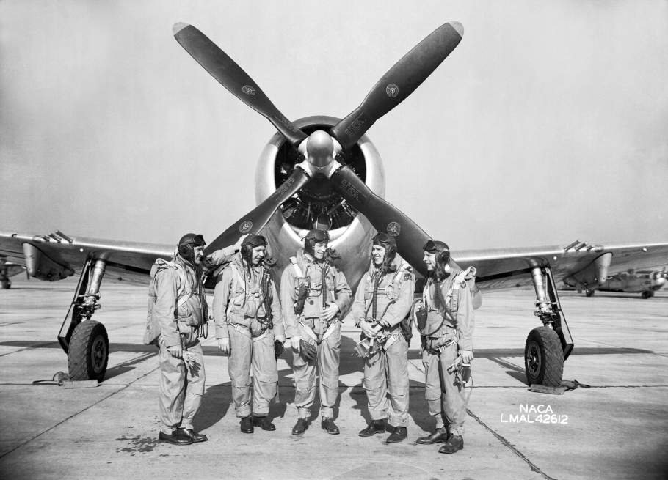
Notes:
NACA test pilots, Bob Gilruth.

Slide 6
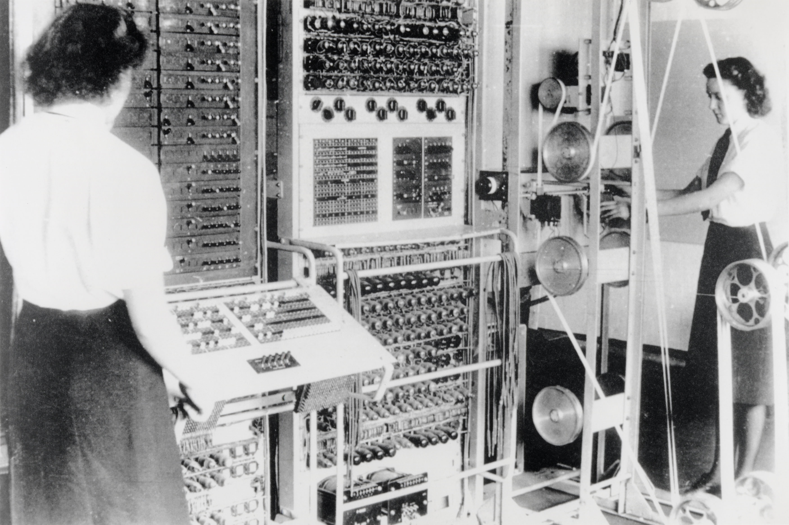
Notes:
A mark 2 colossus based at Bletchley Park being operated by Dorothy Du Boisson (left) and Elsie Booker (right)

Slide 7

bits/minute
2000
billions
a billion
billion
calculations/s
trillions
15 billion
years
20
minutes
embodiment

Slide 8
classical
statistics
data
science

Slide 9
?
!#@%&?
#
!
&
!
£*?$&!
&
?
#

Slide 10
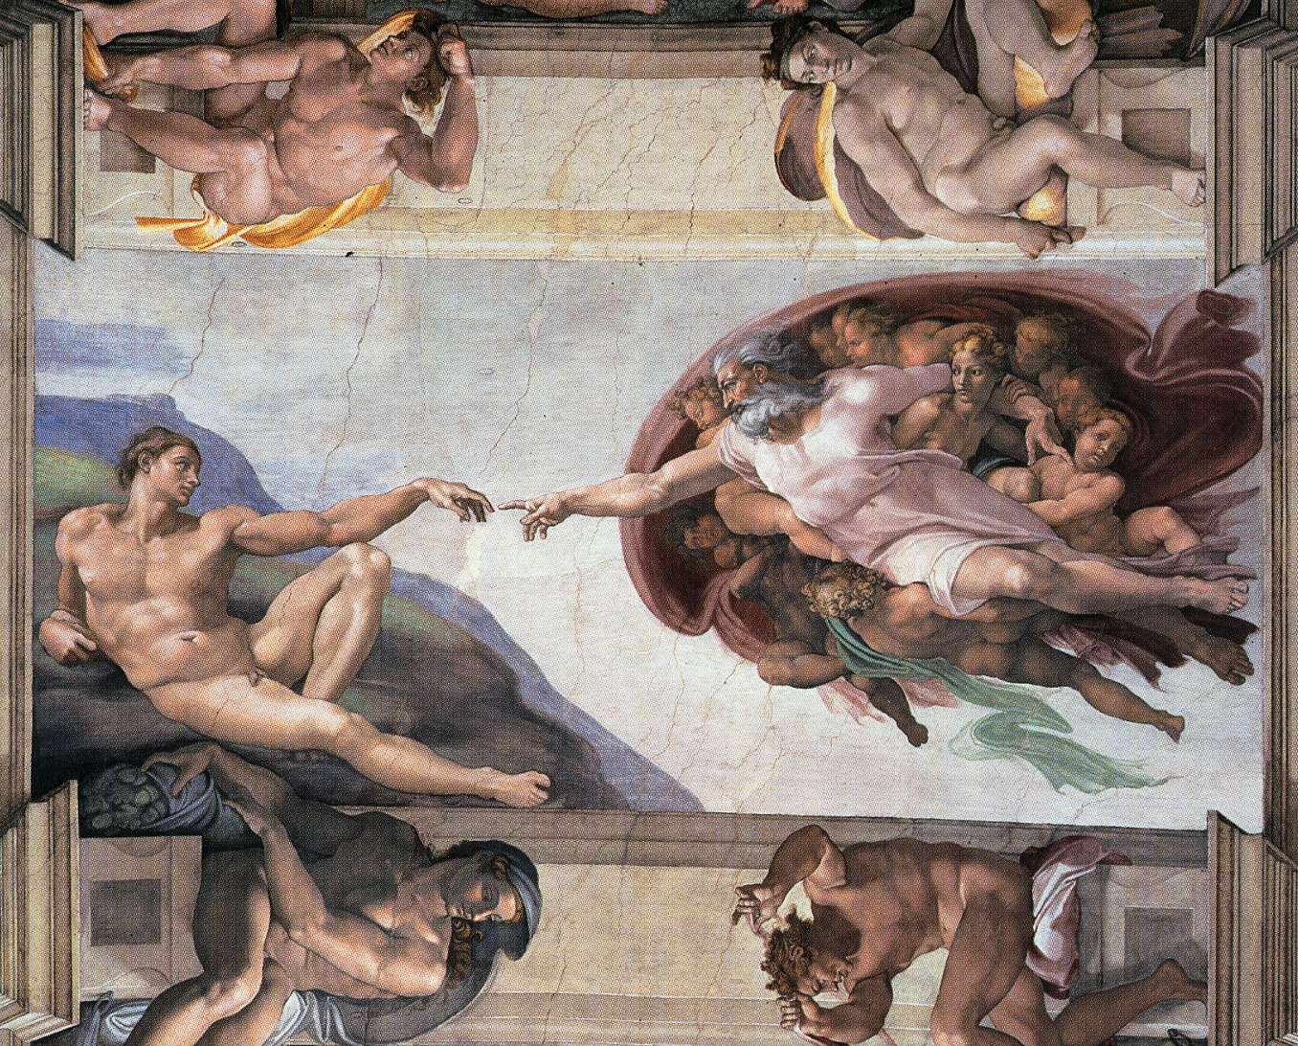

Slide 11
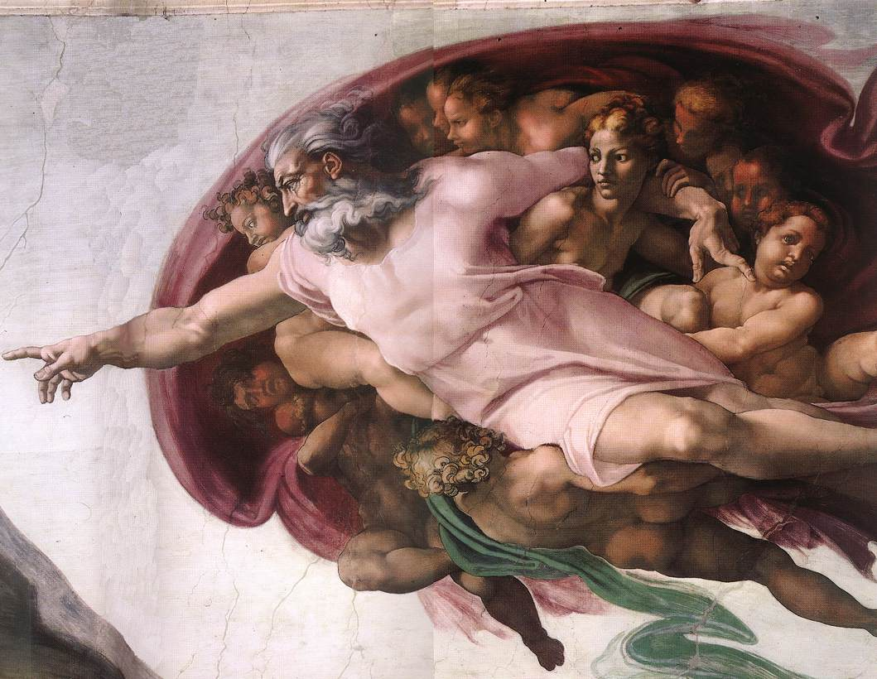

Slide 12
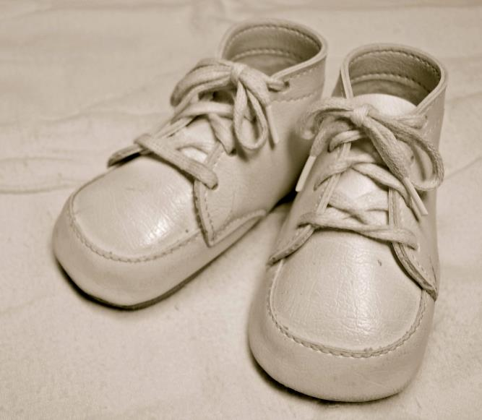
For Sale, Baby Shoes, Never Worn

Slide 13
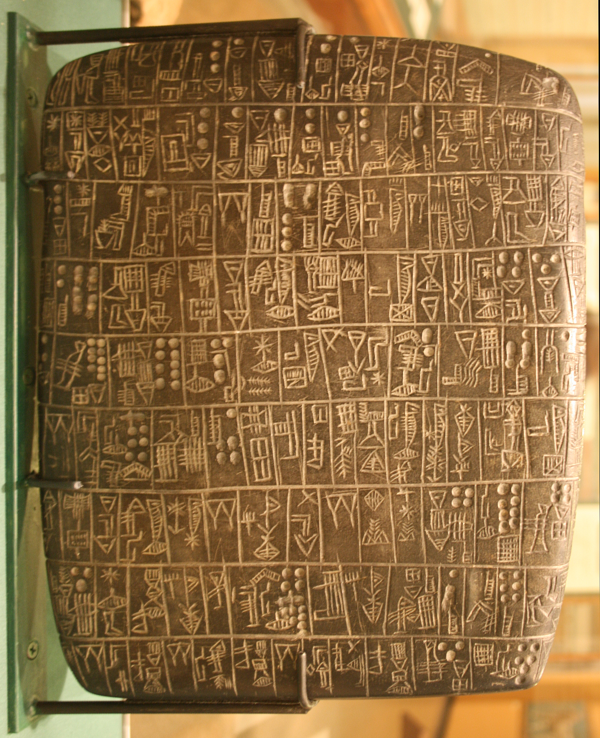
Notes:
Chicago Stone, side 2, recording sale of a number of fields, probably from Isin, Early Dynastic Period, c. 2600 BC, black basalt

Slide 14
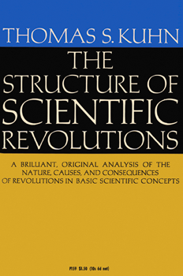

Slide 15
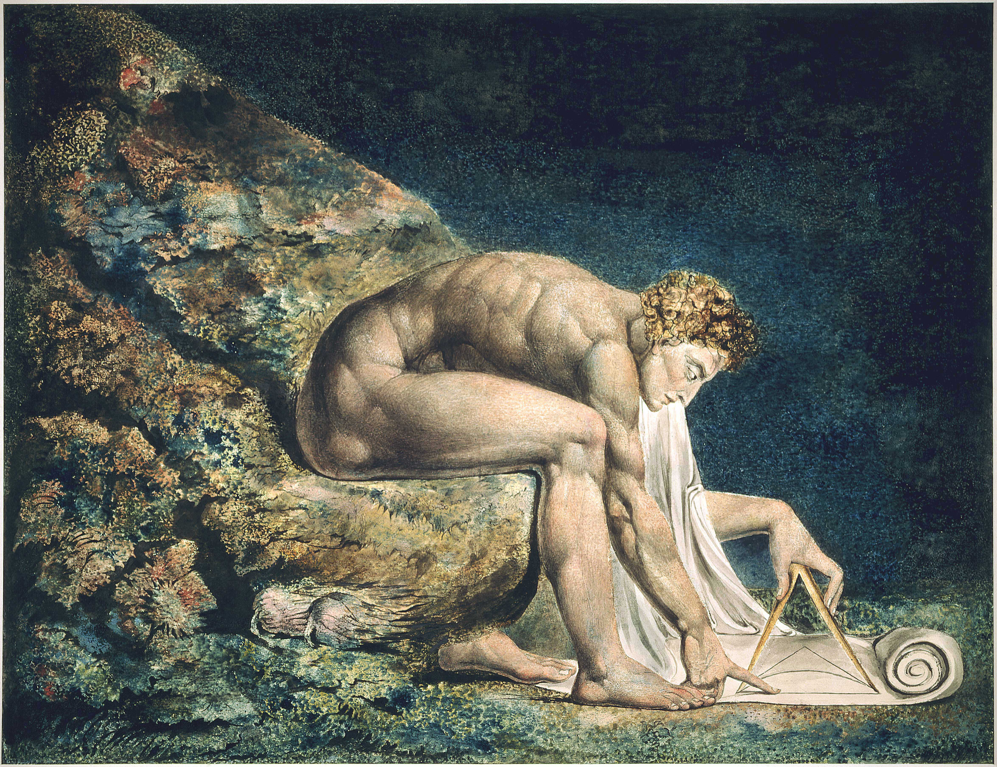

Slide 16
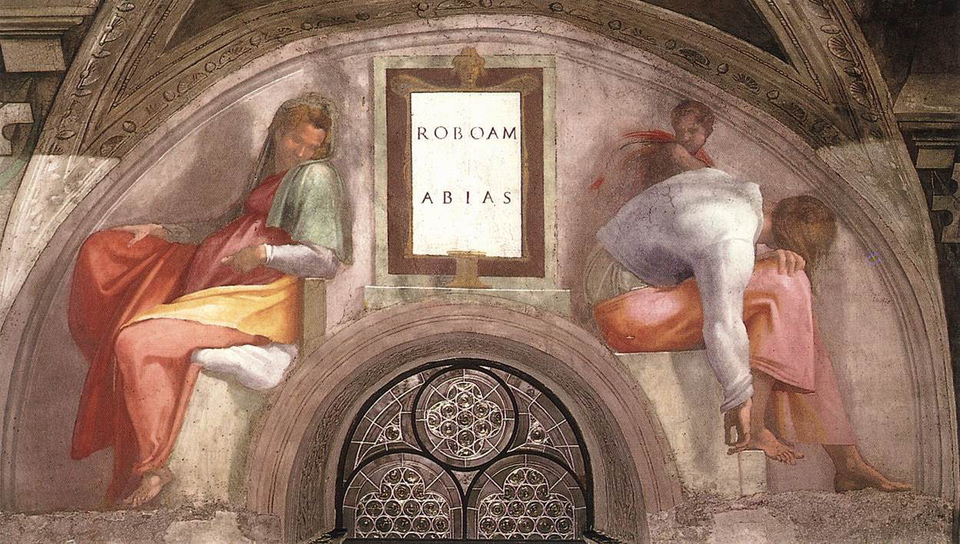

Slide 18
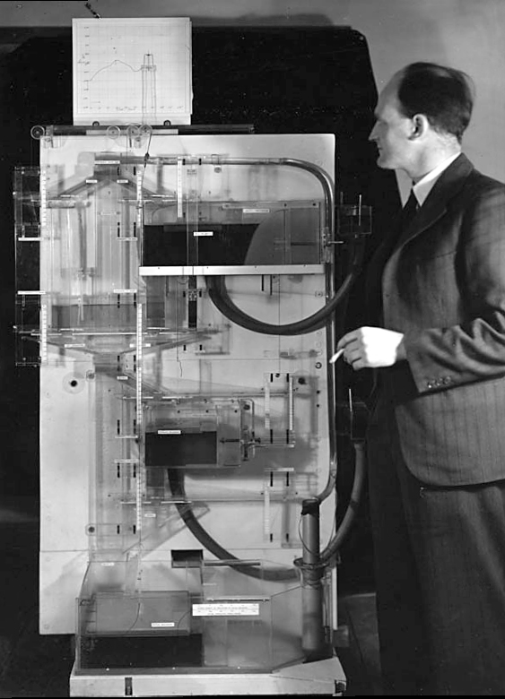
Notes:
Bill Phillips standing next to the MONIAC (completed in 1949)

Slide 20
psychology
classical
statistics
artificial
intelligence
data
science

Slide 22
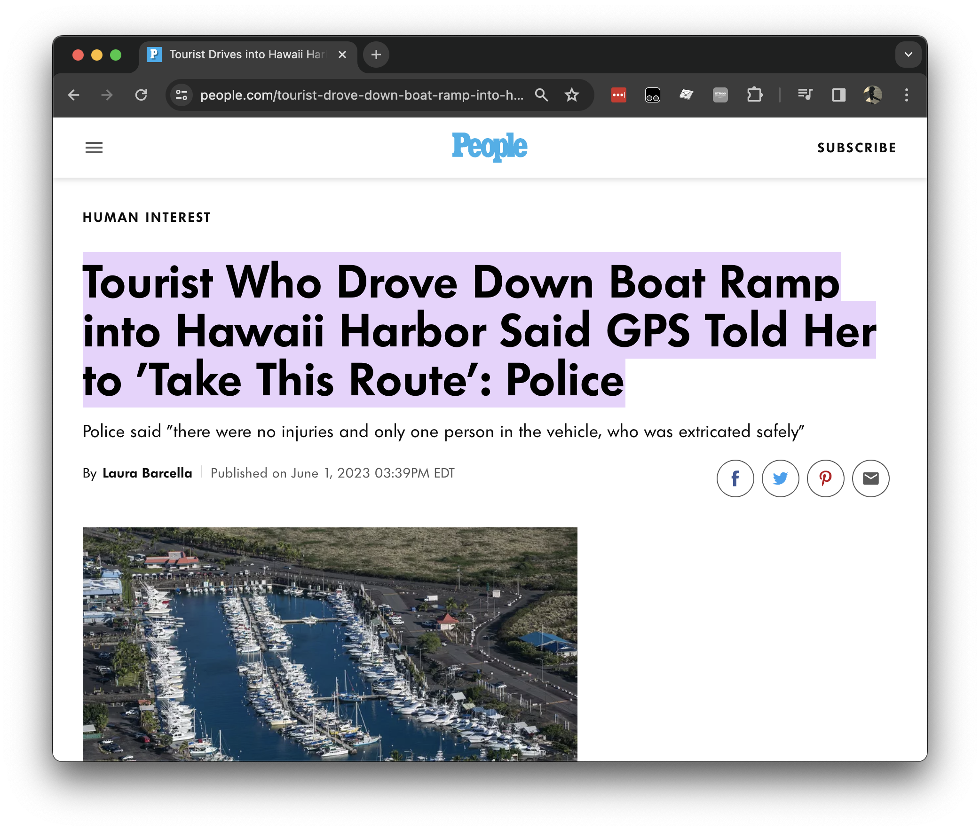

Slide 23
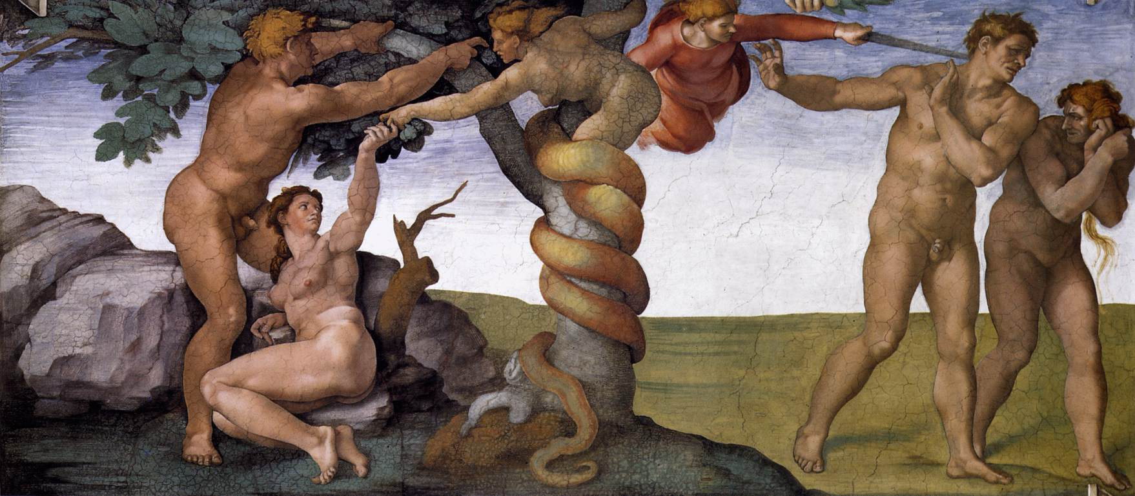

Slide 24
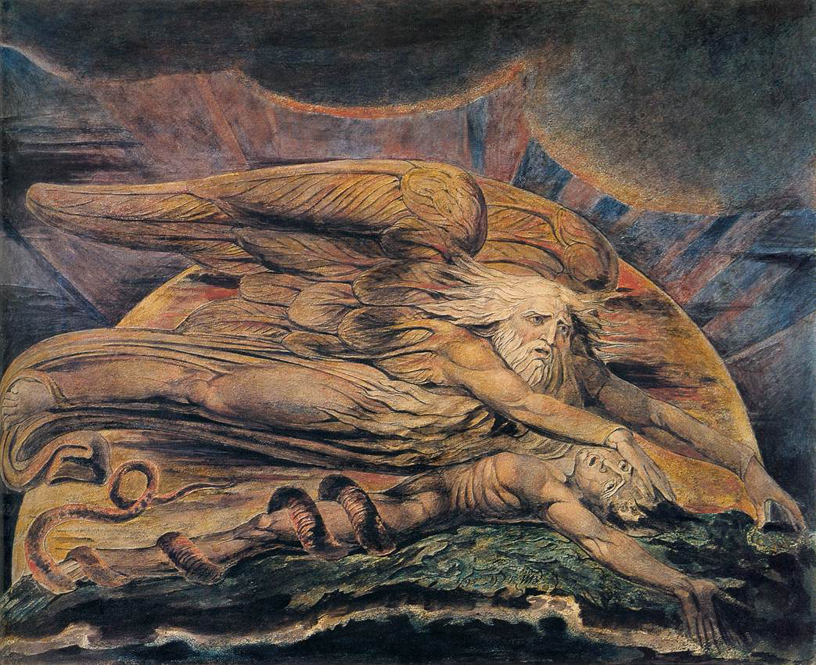

Slide 25
bits/minute
100 x 10⁻⁹
2000
600 x 10⁹

Slide 26
complexity
bandwidth

Slide 27
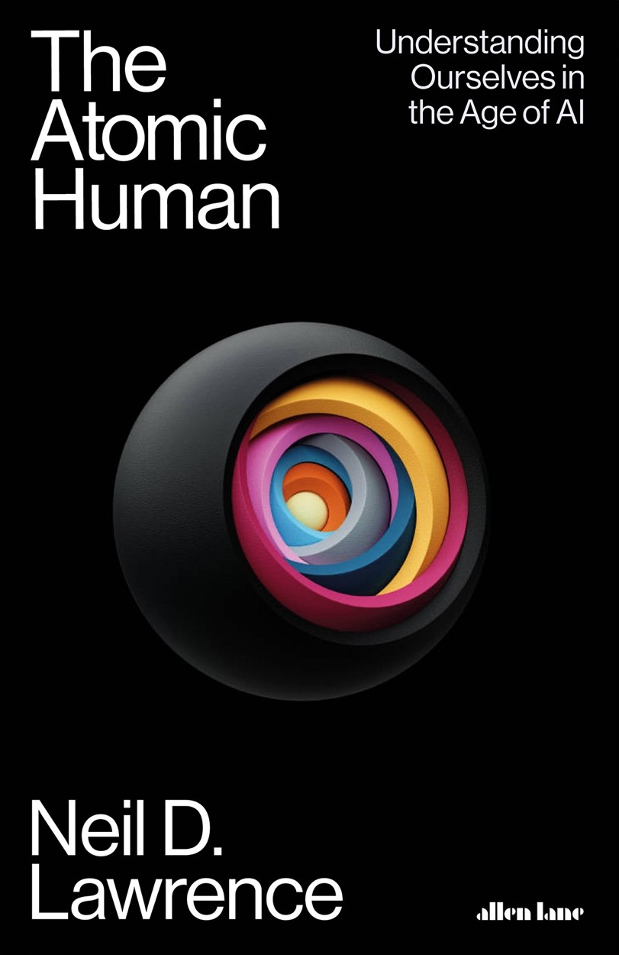
launch on 6th June 2024
Thanks!

